Slide 1

CSE3251
Computer Networks
Dr. Asif Zaman
Professor, CSE, RU

Slide 2
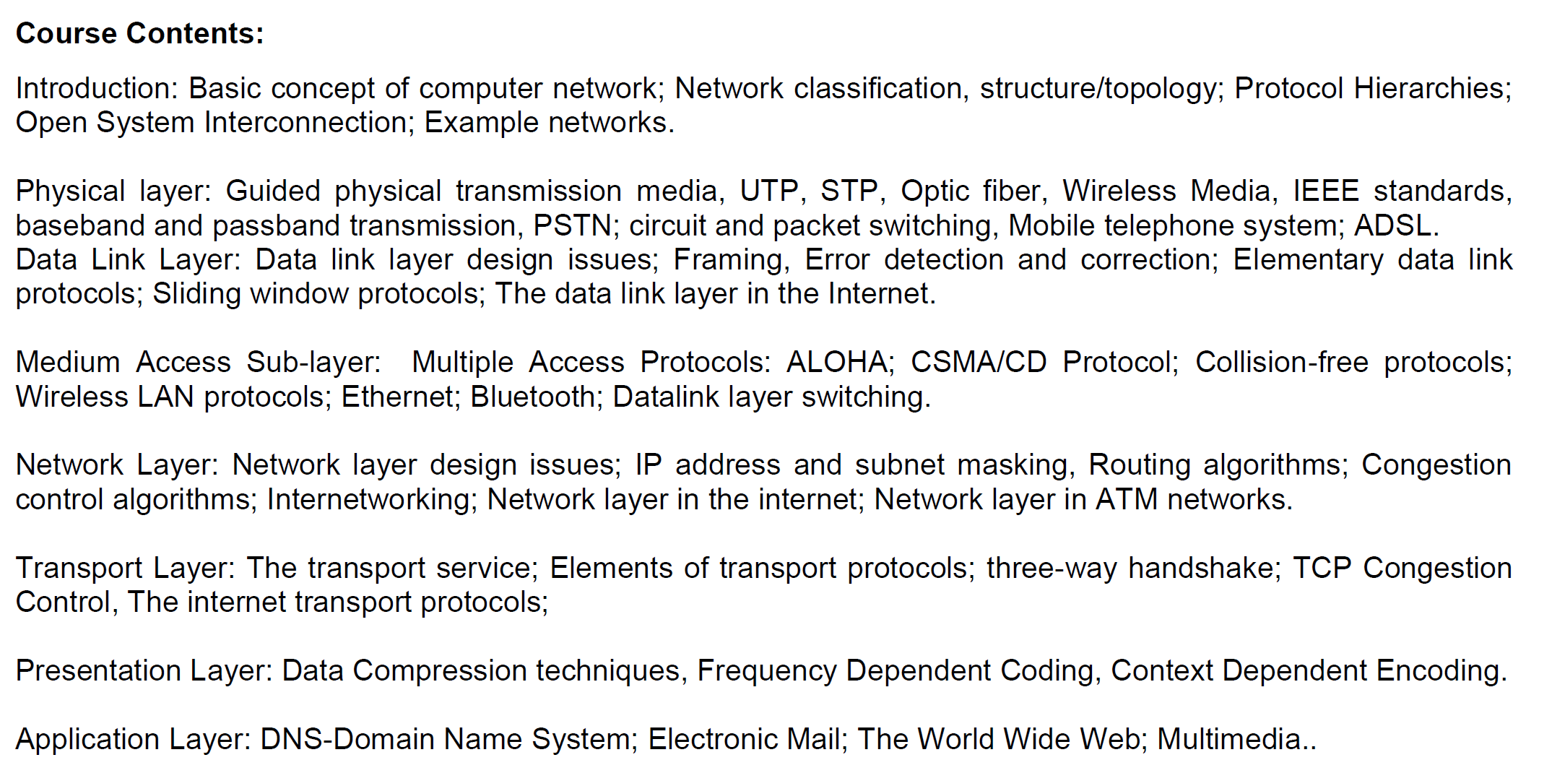

Slide 3
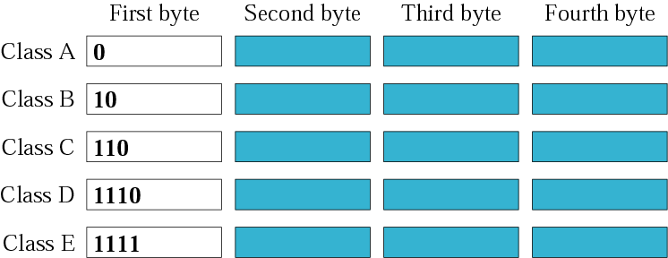
Finding the class in binary notation

Slide 4
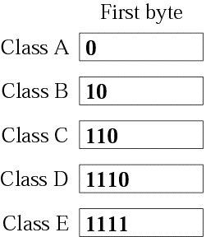
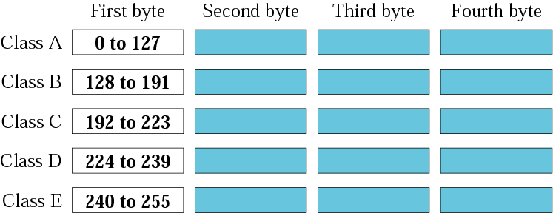
Finding the class in decimal notation
00000000 → 01111111 (127)
10000000 (128) → 10111111 (191)
11000000 (192) → 11011111 (223)

Slide 5
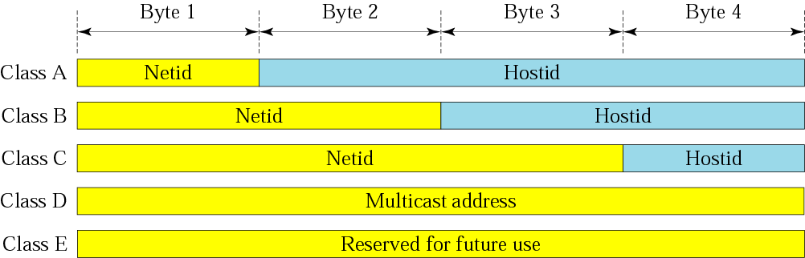
Netid and hostid

Slide 6
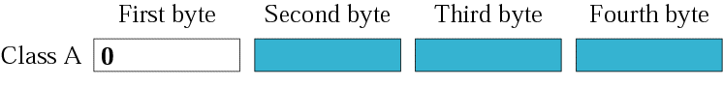
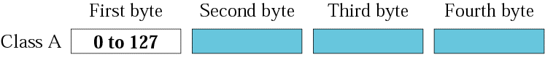
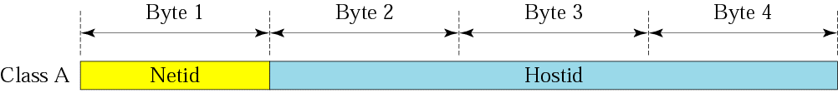
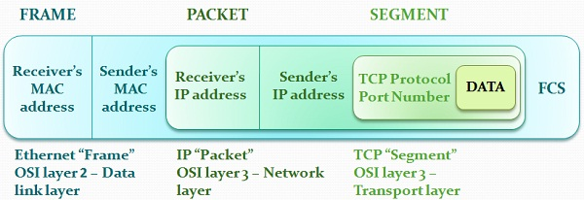
73.X.X.X
Router

Slide 7
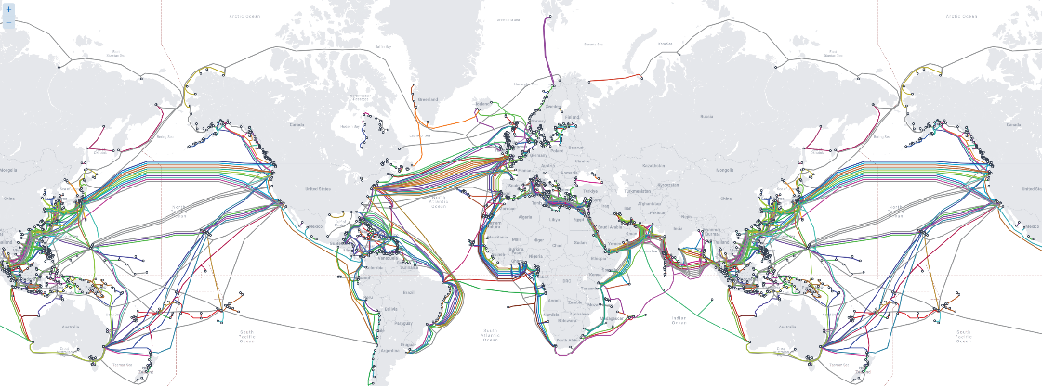
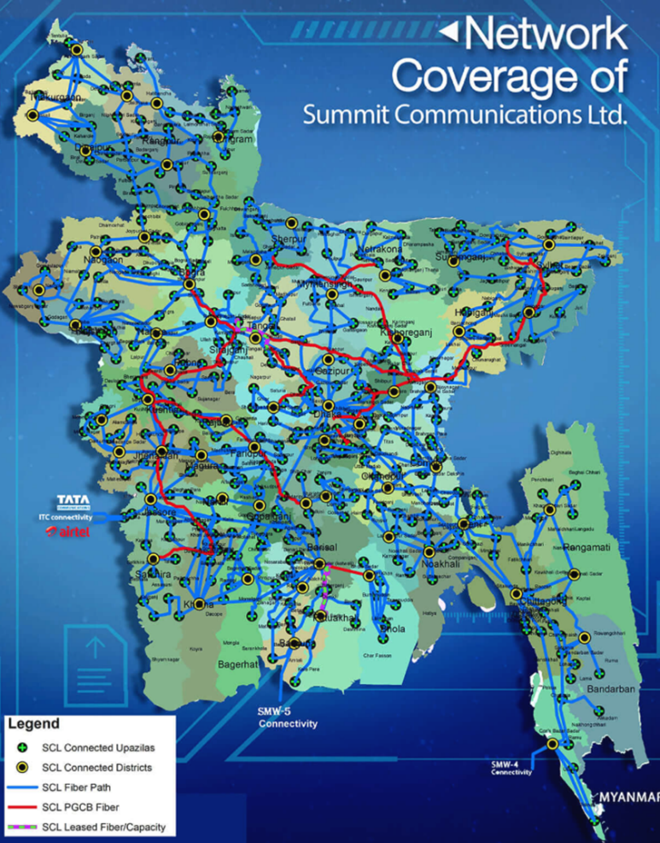
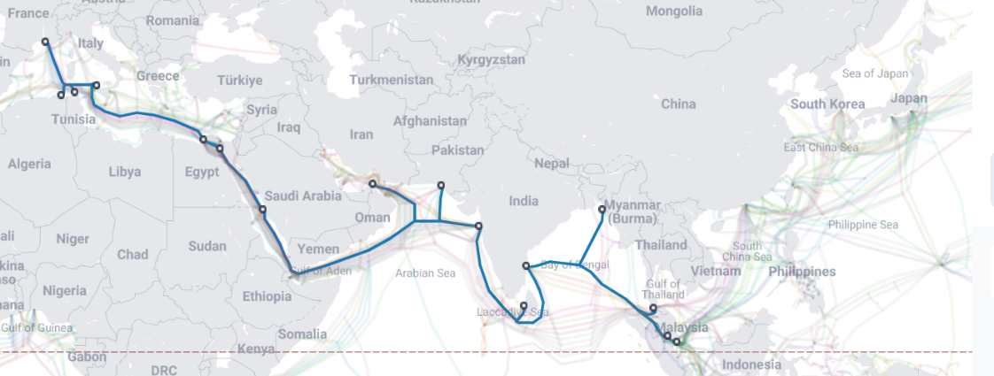
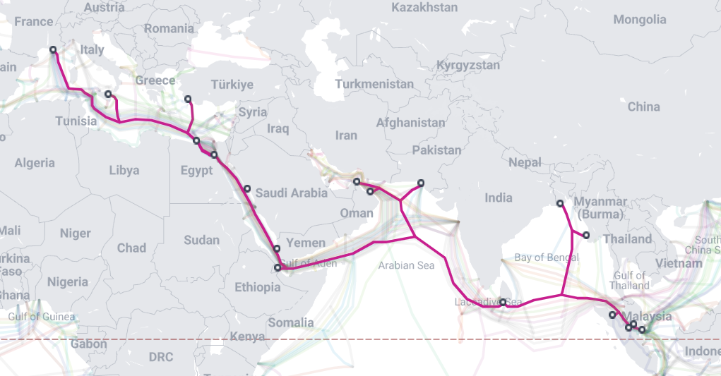

Slide 8
SUBNETTING

Slide 9
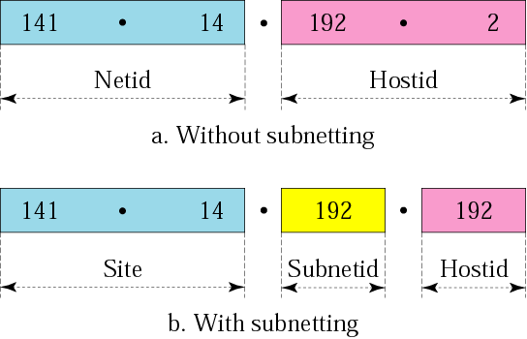
Addresses in a network with and without subnetting

Slide 10
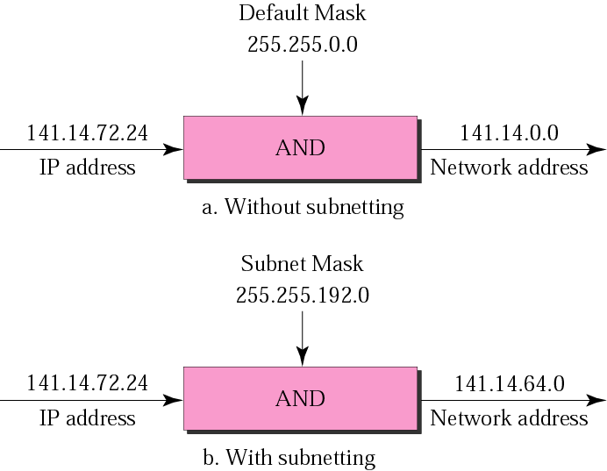
Default mask and subnet mask
72 =01001000
=11000000
01000000=64

Slide 11
Example
What is the subnetwork address if the destination address is 200.45.34.56 and the subnet mask is 255.255.240.0?

Slide 12
Solution
11001000 00101101 00100010 00111000
11111111 11111111 11110000 00000000
11001000 00101101 00100000 00000000
The subnetwork address is 200.45.32.0.

Slide 13
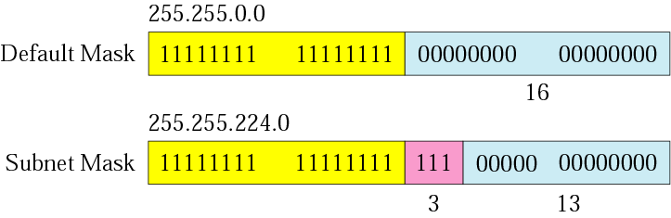
Comparison of a default mask and
a subnet mask

Slide 14
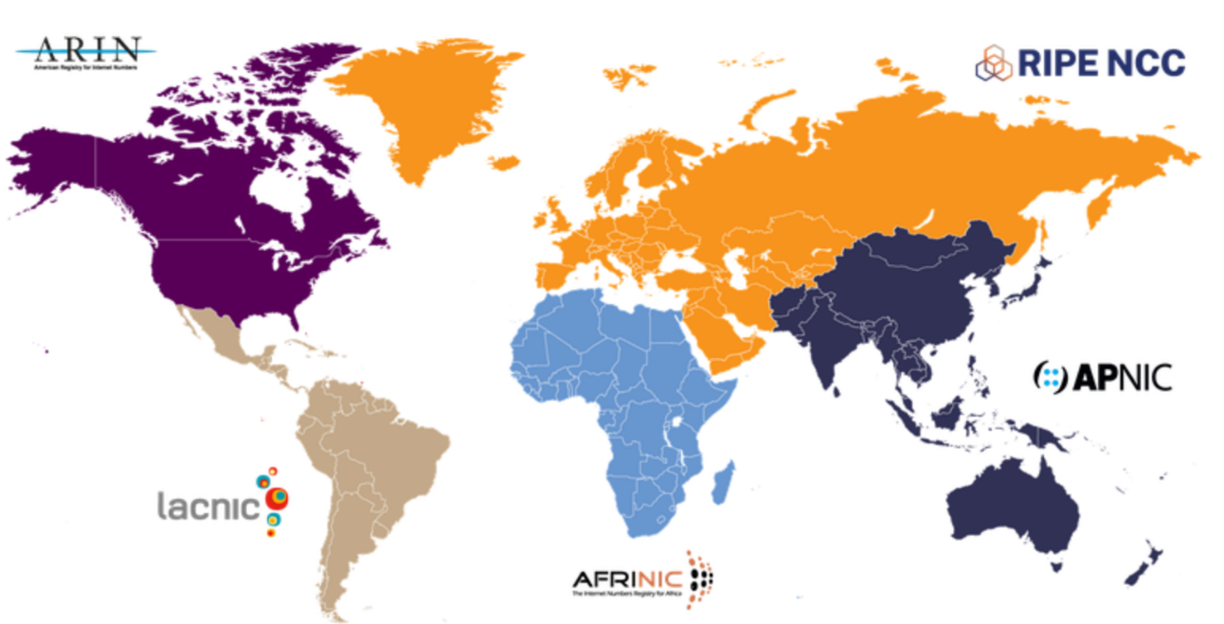
Internet Corporation for Assigned Names and Numbers (ICANN).
Internet Assigned Numbers Authority (IANA)
Regional Internet Registries (RIRs)
A company is granted the site address 201.70.64.0/24 (class C). The company needs six subnets. Design the subnets.

Slide 15
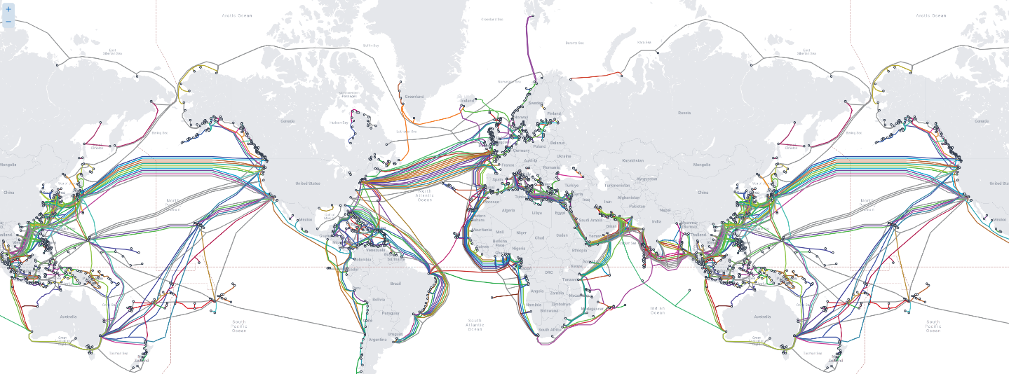

201.70.64.0/24
255.255.255.0
201.70. 01000000.0000 0000
My Company
Network
R1
R
R2

Slide 16
201.70. 01000000.0000 0000
My Company
Network
R
000
001
010
.
.
111
The company needs six subnets.
This number 6 is not a power of 2.
The next number that is a power of 2 is 8 (2³).

Slide 17
Solution (Continued)
We need 3 more 1s in the subnet mask.
The total number of 1s in the subnet mask is 27 (24 + 3).
The total number of 0s is 5 (32 - 27). The mask is
201.70. 01000000.0000 0000
201.70. 01000000.0000 0000

Slide 18
Solution (Continued)
11111111 11111111 11111111 11100000
or
255.255.255.224
The number of subnets is 8.
The number of addresses in each subnet is 2⁵ (5 is the number of 0s) or 32.

Slide 19
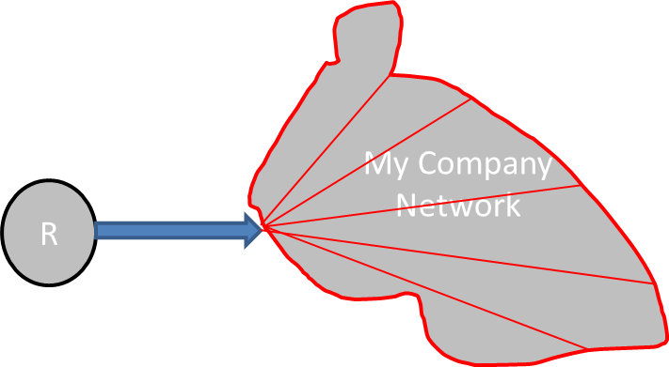
201.70. 64.000 00000
201.70. 64.001 00000
201.70. 64.010 00000
201.70. 64.111 00000
: 201.70.64.0
: 201.70.64.32
: 201.70.64.64
: 201.70.64.224

Slide 20
201.70. 64.000 00000
201.70. 64.000 00001
201.70. 64.000 00010
201.70. 64.000 00011
201.70. 64.000 11111
: 201.70.64.1
: 201.70.64.2
: 201.70.64.3
: 201.70.64.31

Slide 21
201.70. 64.001 00000
201.70. 64.001 00001
201.70. 64.001 00010
201.70. 64.001 00011
201.70. 64.001 11111
: 201.70.64.33
: 201.70.64.34
: 201.70.64.35
: 201.70.64.63

Slide 22
Example
A company is granted the site address 181.56.0.0 (class B). The company needs 1000 subnets. Design the subnets.
Solution
The number of 1s in the default mask is 16 (class B).

Slide 23
Solution (Continued)
The company needs 1000 subnets. This number is not a power of 2. The next number that is a power of 2 is 1024 (2¹⁰). We need 10 more 1s in the subnet mask.
The total number of 1s in the subnet mask is 26 (16 + 10).
The total number of 0s is 6 (32 − 26).

Slide 24
The mask is
11111111 11111111 11111111 11000000
or
255.255.255.192.
The number of subnets is 1024.
The number of addresses in each subnet is 2⁶ (6 is the number of 0s) or 64.
See next slide

Slide 25
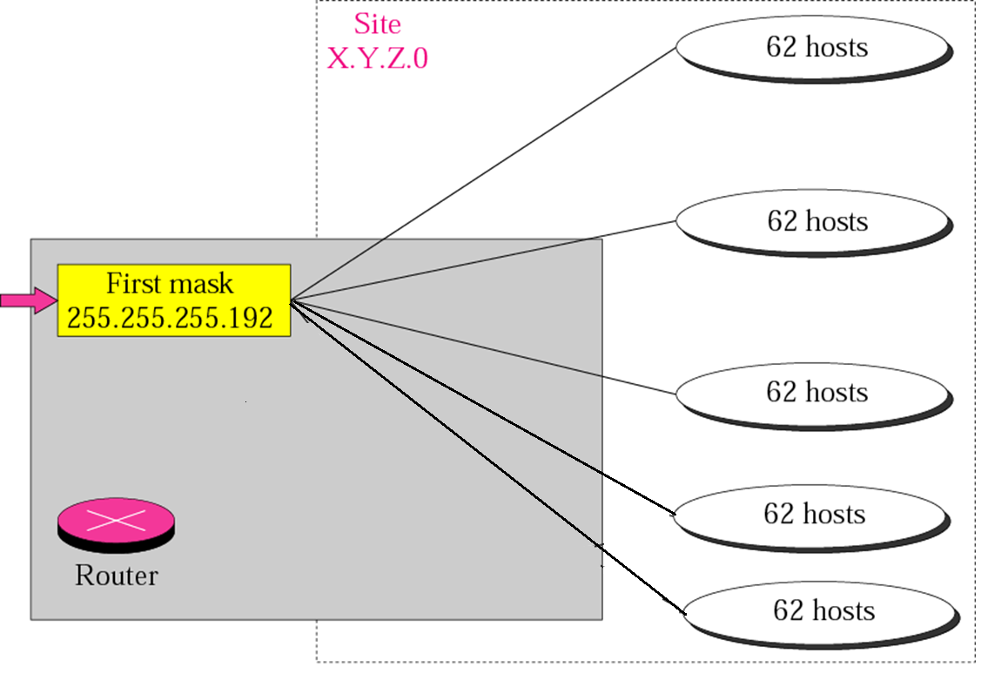
11111111 11111111 11111111 11000000
or
255.255.255.192
2^6=64

Slide 26
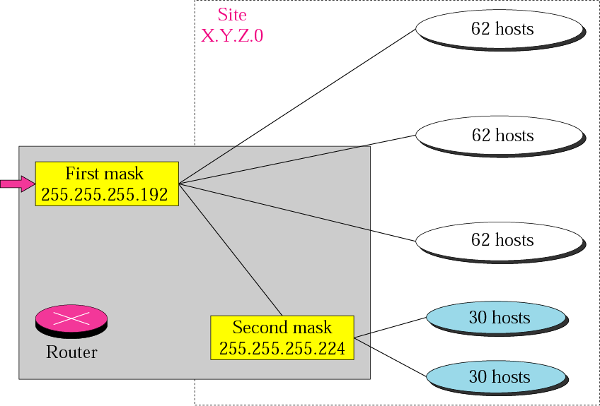
Variable-length subnetting

Slide 27
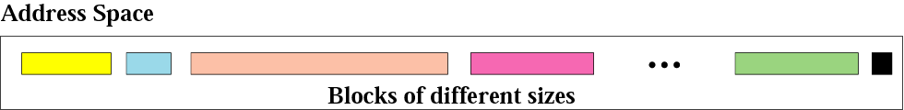
Variable-length blocks

Slide 28
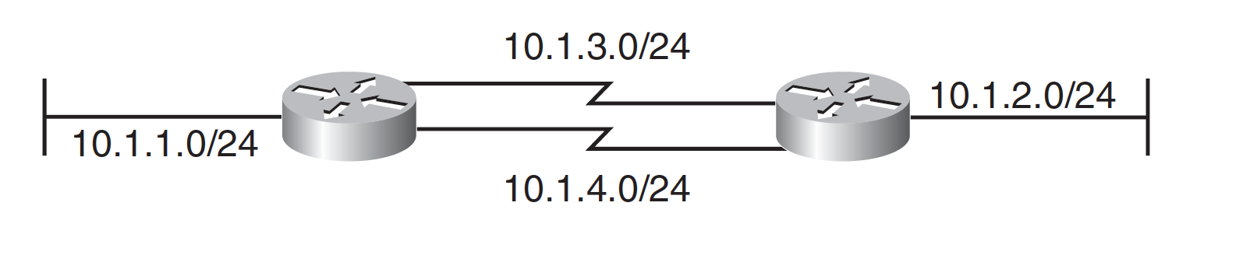
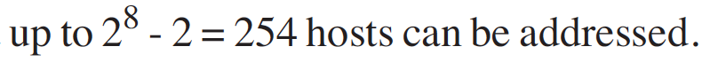
Variable-Length Subnet Masks
Variable-Length Subnet Masks –VLSM

Slide 29
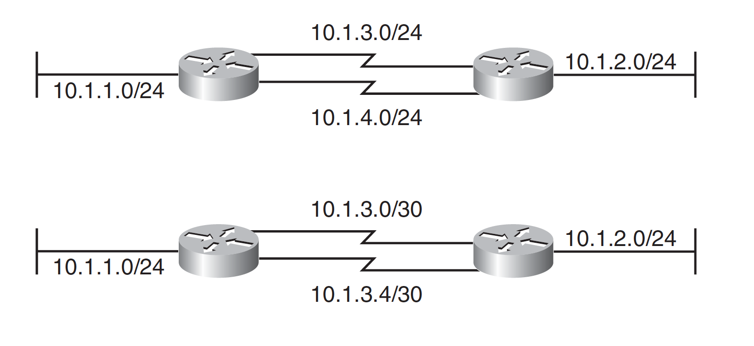
Variable-Length Subnet Masks

Slide 30
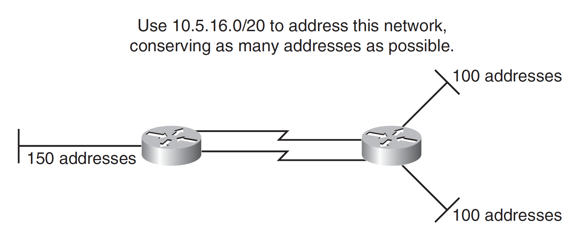
Variable-Length Subnet Masks
If you use any addresses from a subnet, that subnet should not be further subnetted.

Slide 31
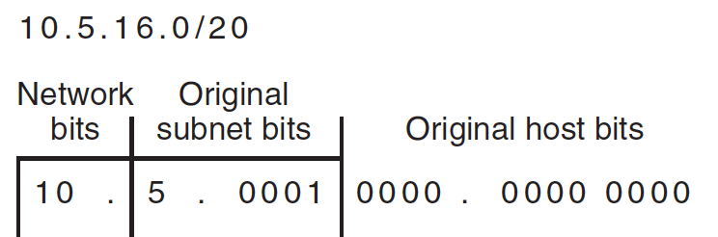

Slide 32
For the left LAN, 150 addresses are needed;
rounding up to the next power of 2 gives 256.
Because 2⁸ = 256, 8 host bits are needed.
For the other two LANs, 100 addresses are needed;
rounding up to the next power of 2 gives 128.
Because 2⁷ = 128, 7 host bits are needed for each LAN.
The WANs require 2 host bits each.

Slide 33
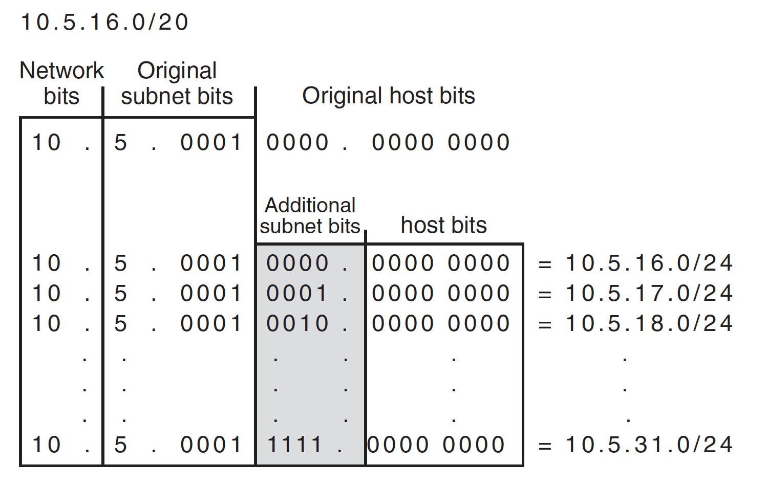
Because at most 8 host bits are needed, the 10.5.16.0/20 address can be further subnetted into sixteen /24 subnets (leaving 8 host bits)

Slide 34
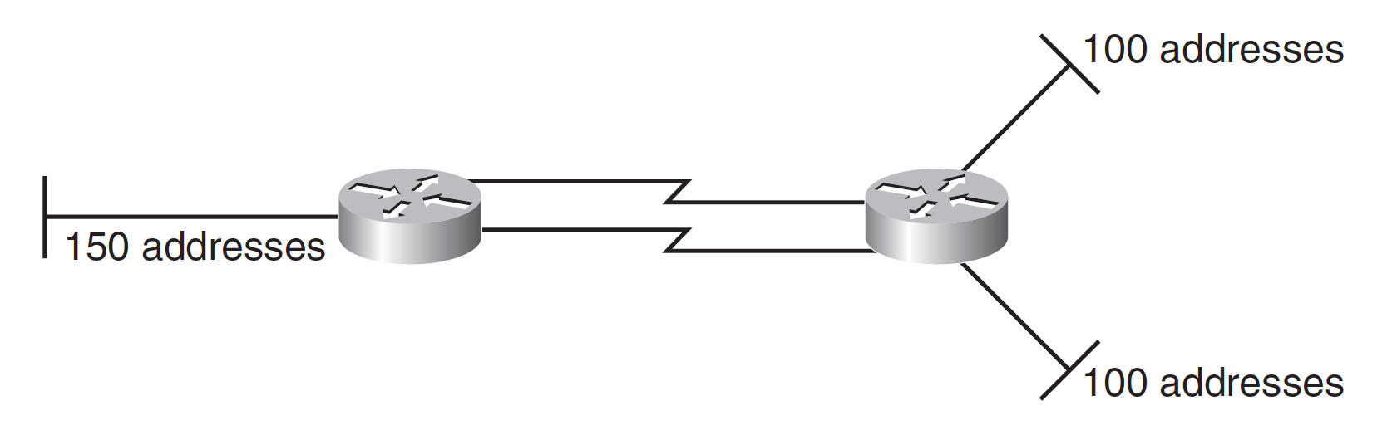
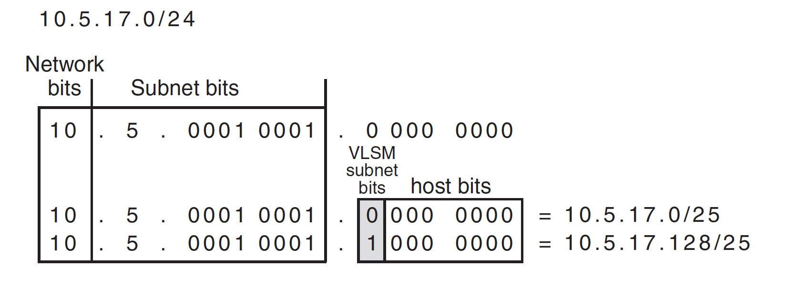

Slide 35

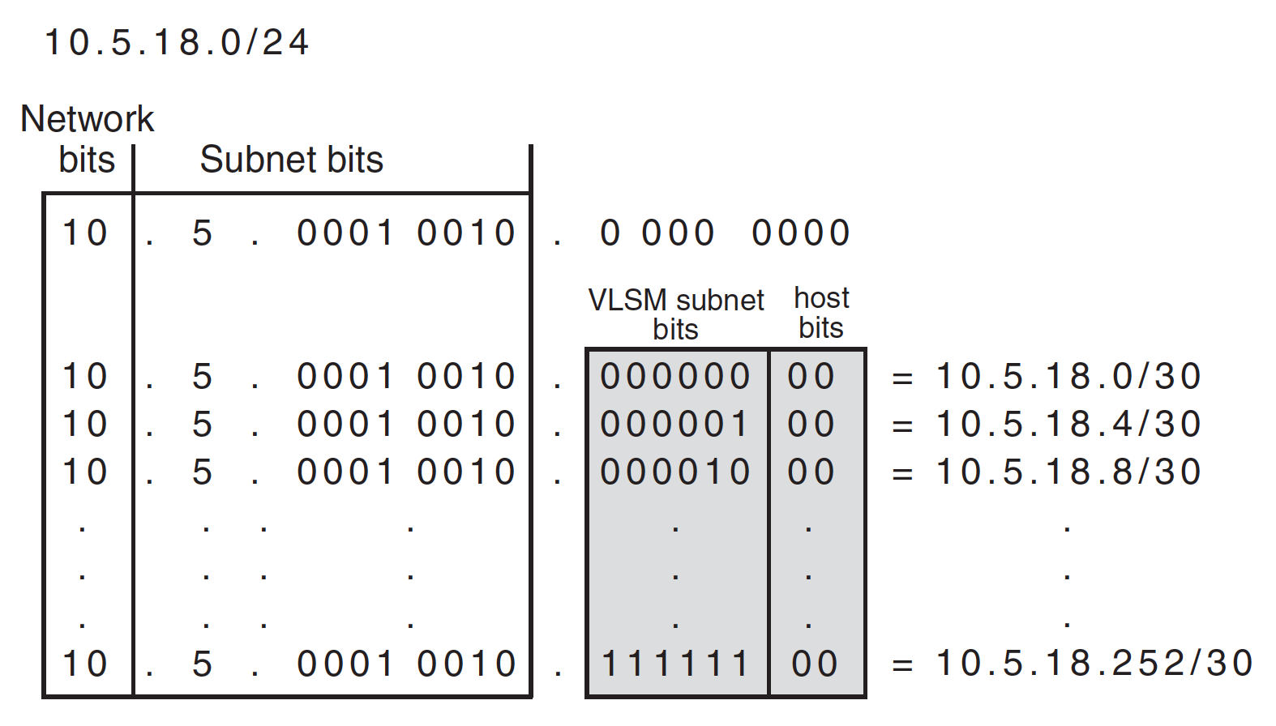
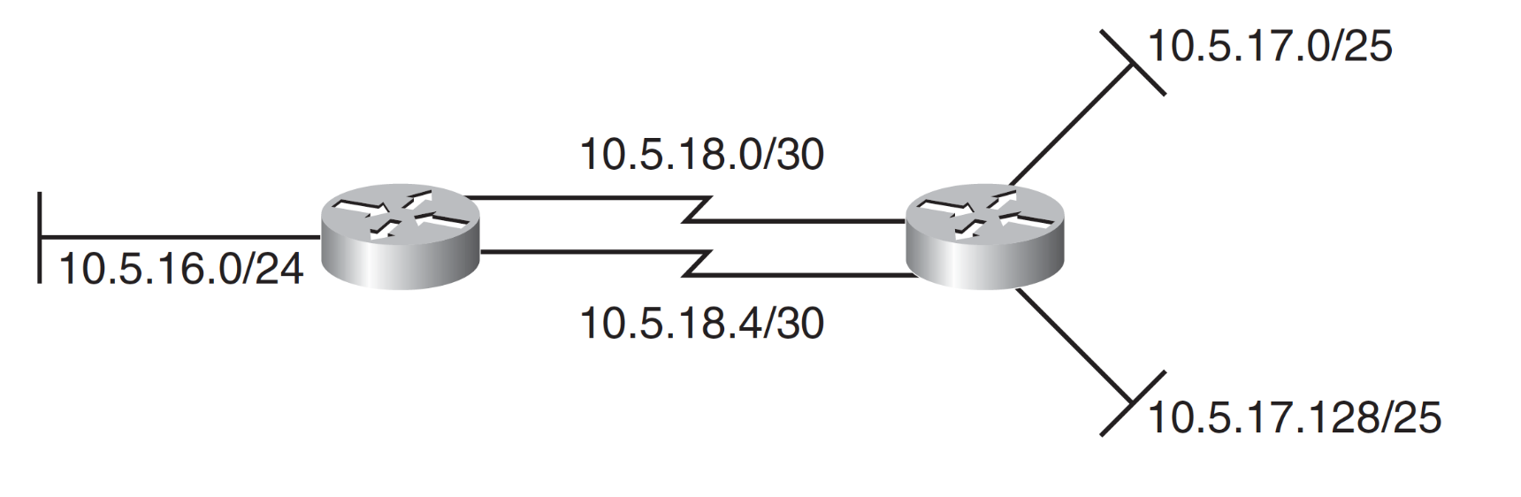

Slide 36
Report Submission
150 addresses
100 addresses
150 addresses

Slide 37
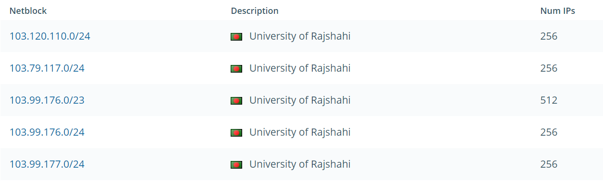
RU IP Block

